Slide 1
Students’ Perspective
Kathryn and Raja

Slide 2
Resources from Dr. Merolla and Dr. Das
General Center for Prevention
https://www.stonybrook.edu/commcms/studentaffairs/cpo/
Let’s talk
https://www.stonybrook.edu/commcms/studentaffairs/cpo/mental-health/lets_talk.php

Slide 3
Places to not be stressed about lab/work/school
Avalon Park
Robert Moses Beach
Lavender farm
Jazz Loft: concerts and dancing
Patchogue (Alive After Five)
$6 Tuesday night movies at AMC Loews
Long Island Aquarium
Trivia at Country Corner

Slide 4
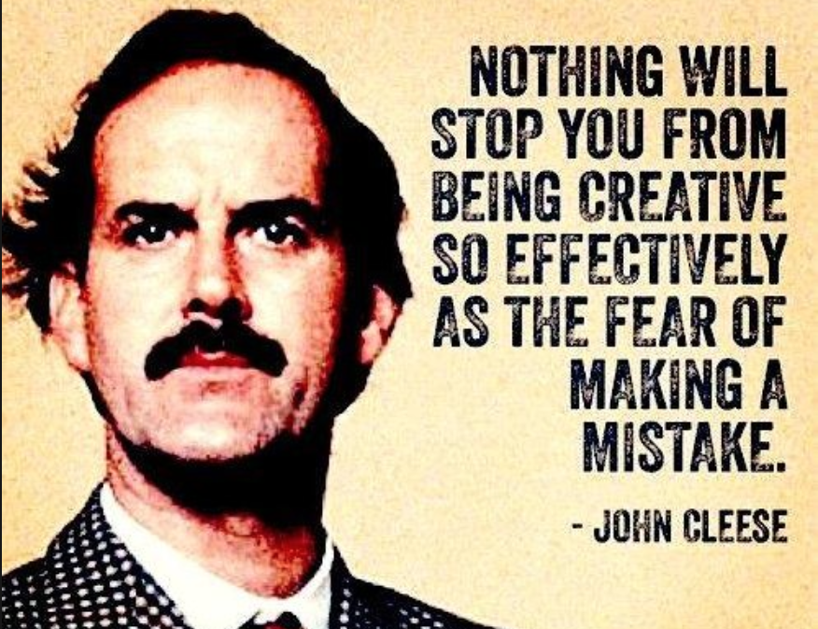
Reminder from John Cleese

Slide 5
Mindfulness resource
https://www.mobile.va.gov/app/mindfulness-coach
This app is put out through Veterans Affairs that helps with daily mindfulness and reframing negative thoughts

Slide 6
NAMI Chapter Renaissance School of Medicine
You’re Not Alone
Last year
This year
Paper resulting from last year’s event

